Slide 1
Fertilization

Slide 2
Objective
Explain the process of fertilization.

Slide 3
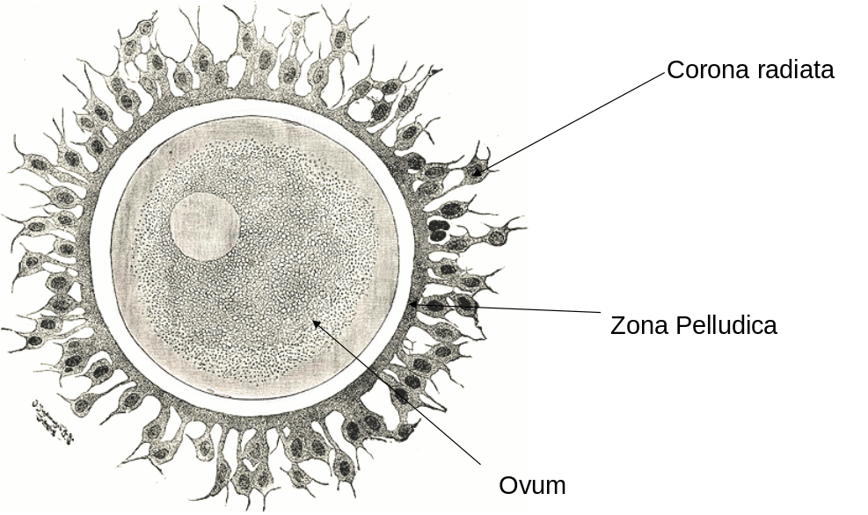
Structure in an ova
The ovum released from the ovary is protected by two layers.
Zona pellucida – It regulates interactions between ovulated eggs and free-swimming sperm during and following fertilization.
Corona radiata - second protective layer. It protects and supplies vital proteins to the ovum.

Slide 4
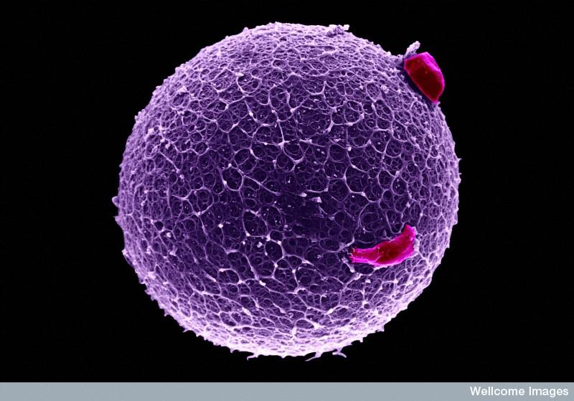
Human egg surrounded by the zona pellucida
Residual coronal cell
Yorgos Nikas , Wellcome Images

Slide 5
Fertilization
Sperm are ejaculated into the vagina.
Travels through the cervix and uterus to the fallopian tubes (oviducts)
If the egg is present and viable, fertilization can occur.

Slide 6
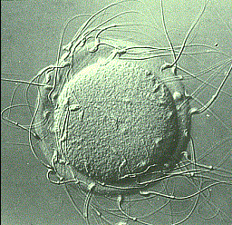
Sperm breakthrough these two layers.
An acid holds the cells of the corona radiata together.
The tip of the sperm contains an enzyme that will break down this acid.
Multiple sperm are required to breakdown this layer.

Slide 7
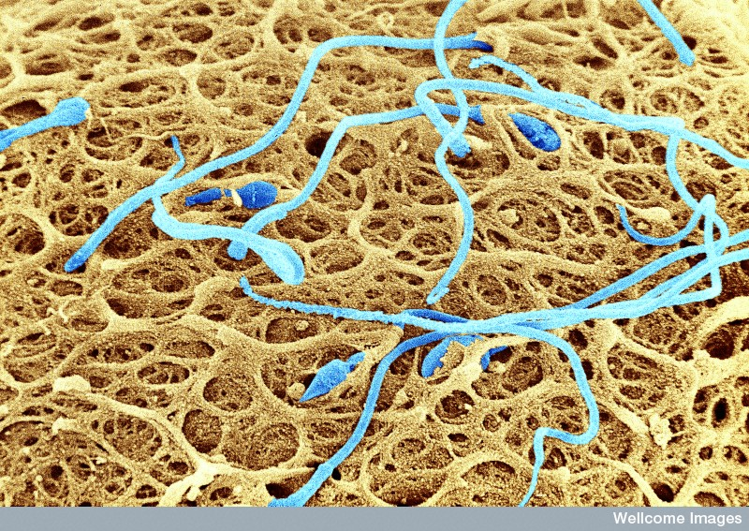
Sperm on the surface of a human egg trying to find their way through the zona pellucida,
Only one sperm then sticks to the ovum, breaking down the corona and fertilize the ovum.
After the sperm enters the egg, the tail and the outer coating of the sperm disintegrate causing a reaction which prevents the other sperm from fertilizing the same egg.
Yorgos Nikas, Wellcome Images

Slide 8
The head of the sperm moves into the cytoplasm and forms the male pronucleus
This triggers the final stages of the second meiotic division of the oocyte
This female pronucleus fuses with the male pronucleus combining the genetic material and forming a nucleus.
It is now called a Zygote.

Slide 9
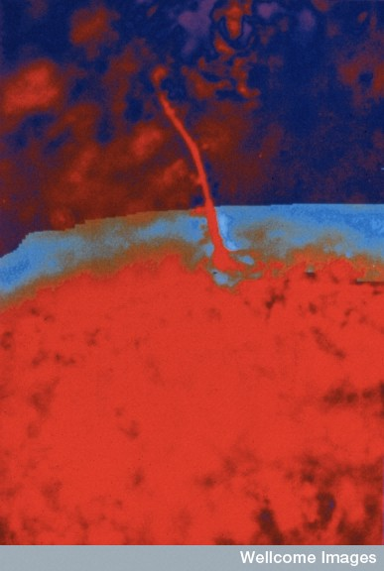
Fertilization of human egg, single sperm entering ovum.

Slide 10


Slide 11
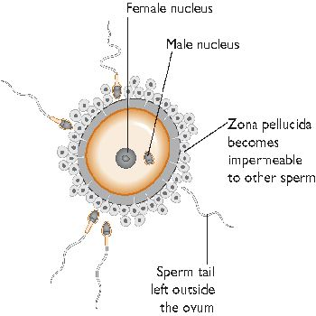

Slide 12
